Slide 1
Recap quiz
Which of the following is not included in the process of creating organizational culture?
Acquire
Embed
Integrate
Implement

Slide 2
Managing Change in Organizations
Expected Learning outcome-
be able to understand how to manage change and the role of resistance to change

Slide 3
Organizational Change
Organizational change is the process by which organizations move from their present state to some desired future state to increase their effectiveness.
Why change is required?
https://www.youtube.com/watch?v=3xMn0o82aL4
Change for growth

Slide 4
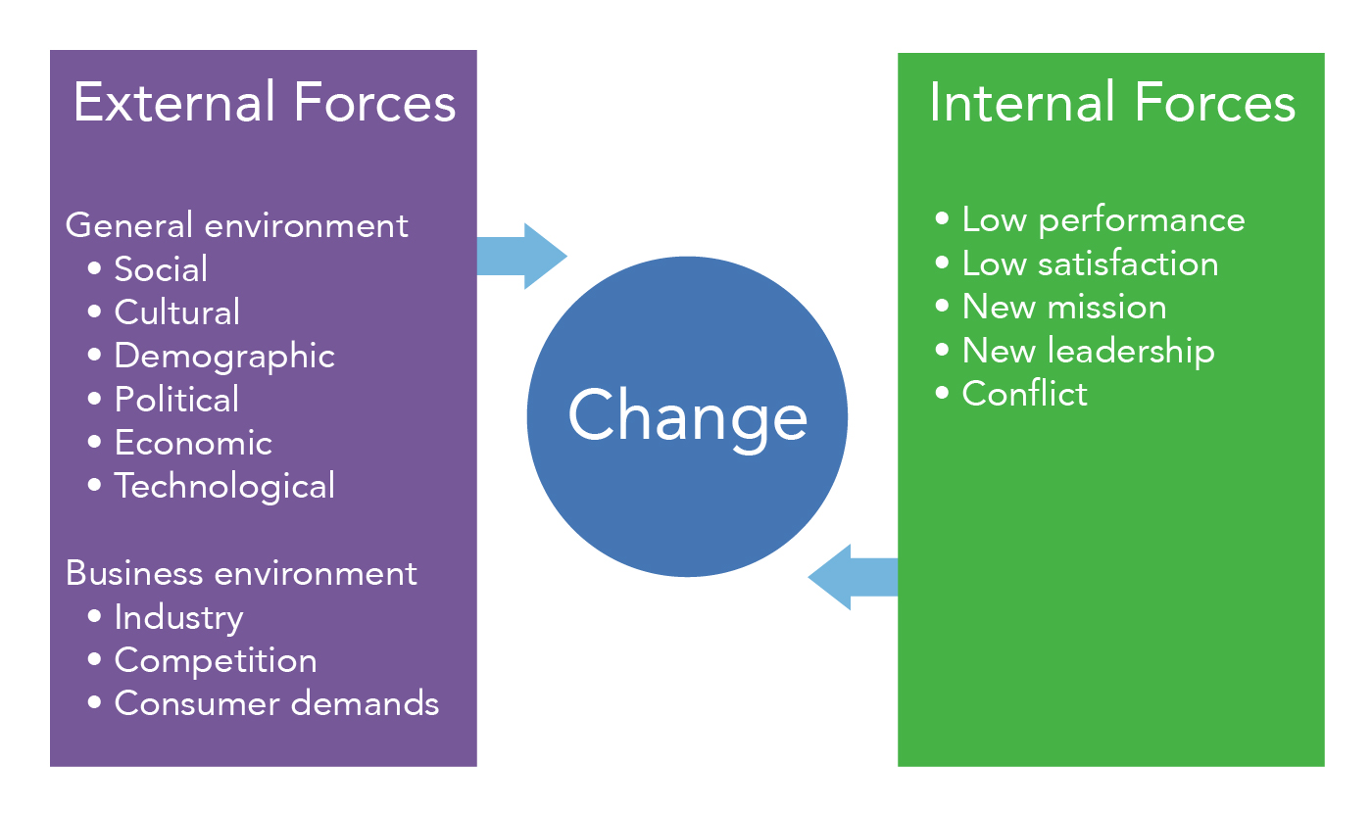
Forces for change

Slide 5
MCQ
An example of internal change forces is –
a. low satisfaction. b. change in demographic features in the country. c. market competitors. d. None of the above

Slide 6
MCQ
Which one of the following is not an example of external forces for change?
Social
Cultural
Technological
New mission

Slide 7
CHANGE MANAGEMENT PROCESS
Define the change.
Select the change management agent
Secure top management support.
Develop implementation plan.
Implement the change—in stages, if possible.
Collect and analyze feedback data.
Quantify gaps and understand resistance.
Modify the plan as needed and look back to the implementation step.

Slide 8
MCQs
What responsibility does a change agent has for the organization?
Identify which group is responsible for failures
Overcome fear of unknown
Determine performance criteria
Reorganize departments

Slide 9
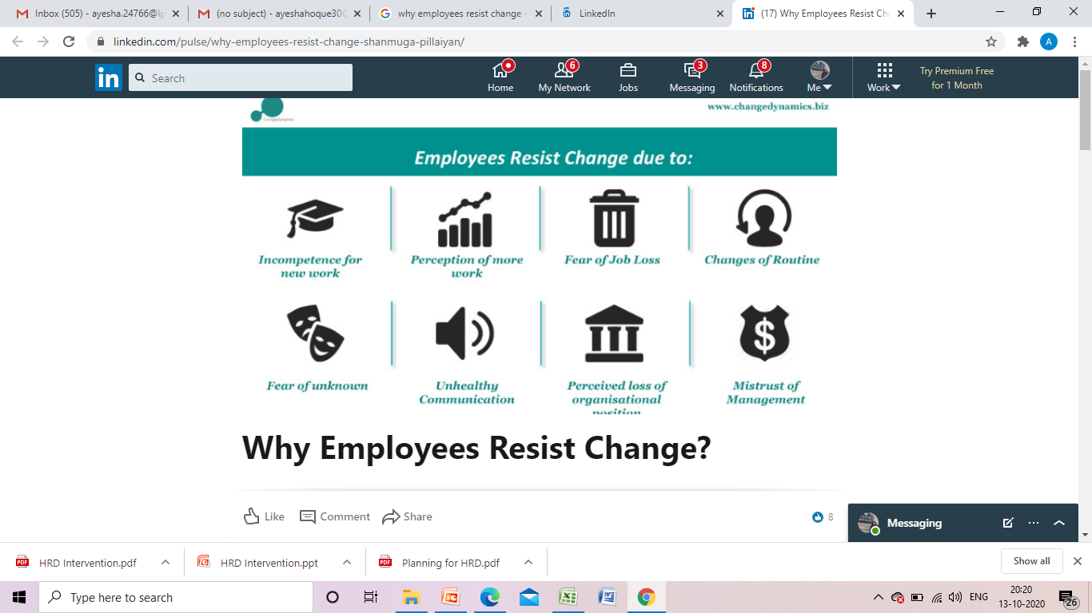

Slide 10
MCQ
Which of the following is not a reason for employee resistance to change?
A. Fear
B. Self interest
C. Habit
D. Job promotion

Slide 11
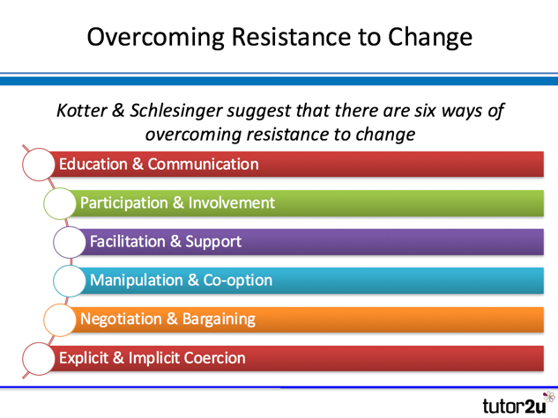
Overcoming resistance to change

Slide 12
Kurt Lewin's Change Model
Kurt Lewin developed a change model involving three steps: unfreeze, change and refreeze.
For Lewin, the process of change entails creating the perception that a change is needed, then moving towards the new, desired level of behavior and finally, solidifying that new behavior as the norm.

Slide 13
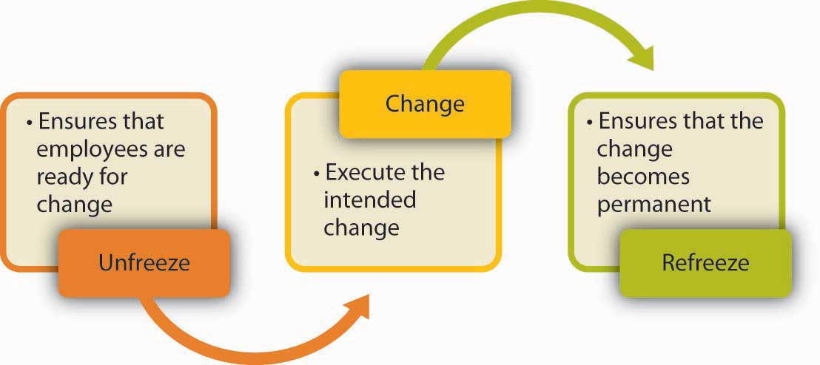
Change Management

Slide 14
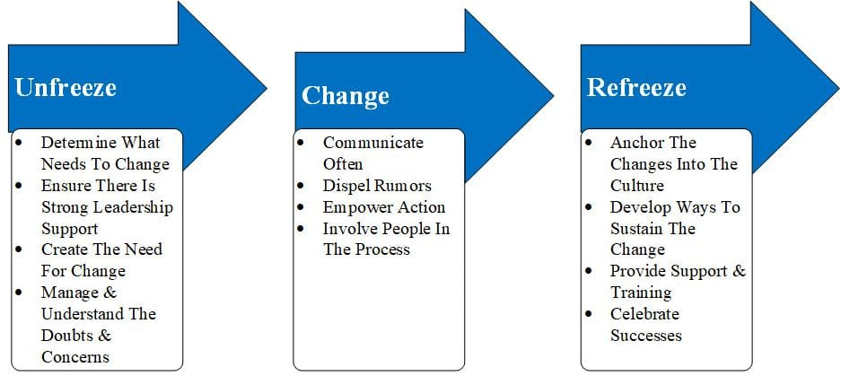
Kurt Lewin’s Model of change

Slide 15
MCQ
According to psychologist Kurt Lewin, which of the following is not a stage in the change process?
a. unfreezing. b. mediating. c. changing. d. refreezing

Slide 16
Recap Quiz
Which one of the following stages means putting aside the old/existing practices in organization?
A. Unfreezing
B. Change
C. Mediating
D. Refreezing

Slide 17
Conflict Management
Expected learning outcome-
to understand benefits of conflict and its management strategies

Slide 18
Can conflict be constructive?

Slide 19
Conflict
A conflict is a clash of interest. The basis of conflict may vary but it is always a part of society. Basis of conflict may be personal, organizational, political and international.
According to Follett, “conflict is the appearance of difference, difference of opinions, difference of interests”.
https://www.youtube.com/watch?v=f3NmLUINP80

Slide 20
Conflict Management
Conflict management involves acquiring skills related to conflict resolution, self-awareness about conflict modes, conflict communication skills, and establishing a structure for management of conflict in your environment.
https://www.youtube.com/watch?v=QLbGHQo4qnA

Slide 21
Characteristics of Conflict:
Conflict is a Process
Conflict is Inevitable
Conflict is a Normal Part of Life
Perception
Opposition

Slide 22
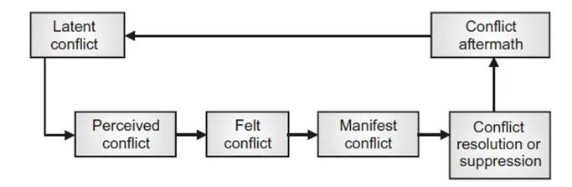
Stages of conflict

Slide 23
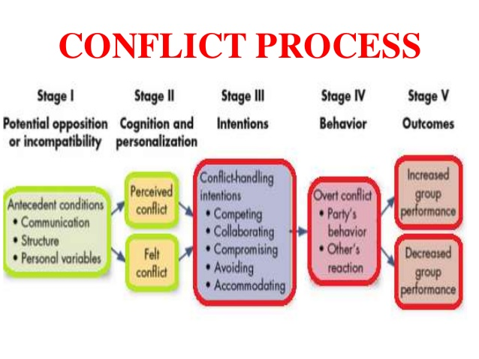

Slide 24
MCQ
A situation which describes a conflict which no one is aware of is called as-
Latent
Perceived
Felt
Manifested

Slide 25
2
Which of the following stage of conflict means conflict is clear and is known to everyone?
Latent
Perceived
Felt
Manifested

Slide 26
Potential Opposition or Incompatibility
Communication. Conflict can arise from, misunderstanding, or noise in the communication channel that hasn’t been clarified. For instance, your new manager, Steve, is leading a project and you’re on the team. Steve is vague about the team’s goals, and when you get to work on your part of the project, Steve shows up half the way through to tell you you’re doing it wrong. This is conflict caused by communication.
Structure. Conflict can arise based on the structure of a group of people who have to work together. For instance, let’s say you sell cars, and your co-worker has to approve the credit of all the people who purchase a vehicle from you. If your co-worker doesn’t approve your customers, then he is standing between you and your commission, your good performance review, and your paycheck. This is a structure that invites conflict.
Personal variables. Conflict can arise if two people who work together just don’t care for each other. Perhaps you work with a man and you find him untrustworthy. Comments he’s made, the way he laughs, the way he talks about his wife and family, all of it just rubs you the wrong way. That’s personal variable, ripe to cause a conflict.

Slide 27
Cognition and Personalization
In the last section, we talked about how conflict only exists if it’s perceived to exist. If it’s been determined that potential opposition or incompatibility exists and both parties feel it, then conflict is developing.
If Joan and her new manager, Mitch, are having a disagreement, they may perceive it but not be personally affected by it. Perhaps Joan is not worried about the disagreement. It is only when both parties understand that conflict is brewing, and they internalize it as something that is affecting them, that this stage is complete.

Slide 28
Intentions
Competing. One party seeks to satisfy his own interests regardless of the impact on the other party.
Collaborating. One party, or both, desire to fully satisfy the concerns of all parties involved in the conflict.
Compromising. Each party to the conflict seeks to give up something to resolve the conflict.
Avoiding. One party withdraws from or suppresses the conflict once it is recognized.
Accommodating. One party seeks to settle the opponent once potential conflict is recognized.

Slide 29
Behavior
Behavior is the stage where conflict becomes evident, as it includes the statements, actions and reactions of the parties involved in the conflict. These behaviors might be overt attempts to get the other party to reveal intentions, but they have a stimulus quality that separates them from the actual intention stage.
Behavior is the actual dynamic process of interaction. Perhaps Party A makes a demand on Party B, Party B argues back, Party A threatens, and so on. The intensity of the behavior falls along a conflict oriented continuum. If the intensity is low, the conflict might just be a minor misunderstanding, and if the intensity is high, the conflict could be an effort to harm or even destroy the other party.

Slide 30
Outcomes
Outcomes of a conflict can be either functional or dysfunctional:
Functional outcomes occur when conflict is constructive.
Dysfunctional outcomes are generally more well known and understood. Uncontrolled opposition breeds discontent, which acts to sever ties and eventually leads to the dissolution of the group.

Slide 31
MCQ
Nesreen supervises a small team, and one of her employees, Allen, continually underperforms. When Nesreen brings up the topic at their next one-on-one meeting, Allen is immediately defensive, and leaves the meeting. Which stage of conflict development are Nesreen and Allen at?
Cognition
Behavior
Outcome
Intention

Slide 32
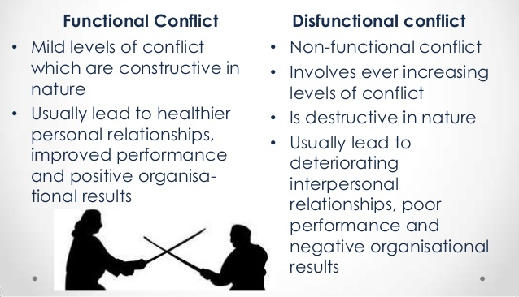
Functional and dysfunctional conflict

Slide 33
MCQ
When the organization’s performance is decreased as a result of conflict, the conflict is termed as-
Functional
Dysfunctional
Behavioral
None of the above

Slide 34
Levels of conflict
Intra-personal
Inter-personal
Intra-group
Inter-group
Intra-organization
Inter-organization

Slide 35
MCQ
Which one of the following statements doesn’t not accurately describe aspects of levels and types of conflict in organizations?
a. Intra-organizational conflict includes all types of conflict between organizations.
b. Interpersonal conflict is conflict between two or more people.
c. Intergroup conflict is conflict between two or more groups.
d. Intrapersonal conflict is conflict that occurs within a person.

Slide 36
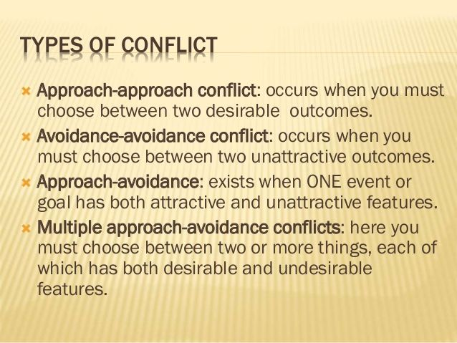
Forms of conflict

Slide 37
……
Role conflict

Slide 38
CONFLICT RESOLUTION
To resolve interpersonal conflict certain approaches are used:
Lose–Lose - In this strategy both the entities tend to lose. One of the solutions can be a compromise made by both the groups. (Compromise)
Win–Lose - In this strategy one entity wins and the other loses. For example, the worker’s union wins or the management of an organization wins. (accommodation /competition)
Win–Win - Using this strategy both the entities win and the brainstorming of views and ideas to solve certain problems happen from positive perspective (collaboration).

Slide 39
MCQ
Which one of the following reflects a win-win situation?
Collaboration
Avoidance
Accommodation
None of the above

Slide 40
CONFLICT MANAGEMENT STYLES
Competition
Collaboration
Compromise
Avoidance
Accommodation

Slide 41
…………..
Competition or Application of Force: In this style, one party is the winner and the other is the loser. This style is used when relationships are not important to a party and the party is aggressive as well as certain about its decision.

Slide 42
……….
Collaboration - In this style both parties are the winner, which promotes good feelings amongst the parties.
Collaboration involves parties or individuals working in coalition towards a common goal or objective and get mutually benefited from the outcome.

Slide 43
………
Compromise -This style is used when chief concern is for attainment of goals and relationships. Both the parties sacrifice some of their goals to achieve a long term goal in collaboration.
This is used when an ideal solution cannot be perceived or all the parties are in equal power proposing their own solution.

Slide 44
…..
Avoidance -This style can be used when issue is not major or too much of conflict has an impact on the relationship or when there is very little scope to fulfill a party’s own needs or when to reach to a solution can incur delay

Slide 45
…….
Accommodation -This style helps in improving relationships and harmony and time is a constrained variable for resolving issues. Smoothing is keeping in priority other people’s concern.

Slide 46
MCQ
When the relationship is important which style of conflict management will be better?
Competition
Avoidance
Accommodation
None of the above

Slide 47
When a person experiences conflict due to multiple roles assigned to him it is known as-
Role conflict
Affective conflict
Person conflict
None of the above

Slide 48
Which of the following is NOT one of the Big Five traits? a. sense of humor b. openness to experience c. conscientiousness d. extraversion

Slide 49
Lana is friendly, always willing to help others and compassionate. We would expect Lana to score highly on: a. extraversion b. agreeableness c. neuroticism d. openness to experience

Slide 50
Why it is important to manage conflict in organizations?

